Slide 1
END OF CYCLE ASSESSMENT APRIL 2022

Slide 2
Activity
In groups, discuss the following
What is End of Cycle Assessment in the LSC?
Discuss the difference between summative assessment in a knowledge based curriculum and in a competence based curriculum
How best can teachers prepare learners for end of cycle assessment?
What are High Order Thinking Skills (HOTs)?
Present to plenary.

Slide 3
Key points
End of Cycle Assessment is summative assessment at the end of Senior Four, consisting of examinations by UNEB which will cater for the 80% of the total grade per subject.
In a CBC, learners are required to give the application of the knowledge in day to day life
Teachers are urged to concentrate on the 20% (ie continuous class activities and formative assessment, projects, and co-curricular activities) to develop the ‘KUSVA’, competencies,. With this, they will be in position to perform well in the End.

Slide 4
Key points
The End of Cycle Assessment in a competence based curriculum will test High Order Thinking skills and not just knowledge questions.
Higher-order thinking skills (HOTS) are reflected by the top three levels in Bloom’s Taxonomy, a framework designed to promote higher forms of thinking in education, such as analyzing and evaluating, rather than just teaching students to remember facts (rote learning).

Slide 5
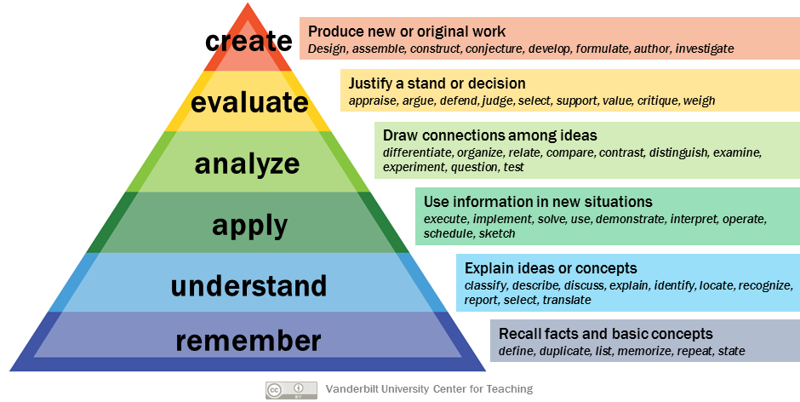
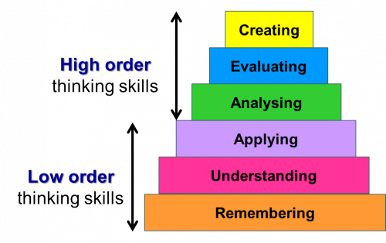

Key points
Blooms Taxonomy

Slide 6
Examination formats
END OF CYCLE ASSESSMENT
NB: UNEB to officially publish final exam formats and sample examination question papers

Slide 7
English Language
END OF CYCLE ASSESSMENT: EXAM FORMAT
No of Papers | Paper Structure | Marks | Duration
2 | Paper 1 is functional writing with two sections. Candidates attempt one item from each section | 40 | 1 hr 20 min
 | Paper 2 assesses areas of summary, comprehension and grammar | 60 | 2 hrs

Slide 8
Literature in English
END OF CYCLE ASSESSMENT: EXAM FORMAT
No of Papers | Paper Structure | Marks | Duration
1 | The paper has four sections covering poetry, drama, the novel and prose | 80 | 2 hrs

Slide 9
Mathematics
END OF CYCLE ASSESSMENT: EXAM FORMAT
No of Papers | Paper Structure | Marks | Duration
2 | Paper 1 has two sections. All questions are compulsory | 100 | 2 hrs
 | Paper 2 is functional Mathematics consisting of six items and a candidate attempts four items | 100 | 2 hrs

Slide 10
Physics
END OF CYCLE ASSESSMENT: EXAM FORMAT
No of Papers | Paper Structure | Marks | Duration
2 | Paper 1 is a theory paper consisting of two sections. Section A is compulsory while Section B consists of six items out of which a candidate attempts four items | 100 | 2 hrs 15 min
 | Paper 2 is a practical paper consisting of three items out of which a candidate attempts 2 items | 60 | 2 hrs 15 min

Slide 11
Physics
END OF CYCLE ASSESSMENT: EXAM FORMAT
No of Papers | Paper Structure | Marks | Duration
2 | Paper 1 is a theory paper consisting of two sections. Section A is compulsory while Section B consists of six items out of which a candidate attempts four items | 100 | 2 hrs 15 min
 | Paper 2 is a practical paper consisting of three items out of which a candidate attempts 2 items | 60 | 2 hrs 15 min

Slide 12
Chemistry
END OF CYCLE ASSESSMENT: EXAM FORMAT
No of Papers | Paper Structure | Marks | Duration
2 | Paper 1 is a theory paper consisting of two sections. Section A is compulsory while Section B consists of six items out of which a candidate attempts four items | 100 | 2 hrs 30 min
 | Paper 2 is a practical paper consisting of one compulsory item | 30 | 2 hrs

Slide 13
Biology
END OF CYCLE ASSESSMENT: EXAM FORMAT
No of Papers | Paper Structure | Marks | Duration
2 | Paper 1 is a theory paper consisting of two sections. Section A is compulsory while Section B consists of six items out of which a candidate attempts four items | 100 | 2 hrs 30 min
 | Paper 2 is a practical paper consisting of two compulsory items | 60 | 2 hrs 15 min

Slide 14
General Science
END OF CYCLE ASSESSMENT: EXAM FORMAT
No of Papers | Paper Structure | Marks | Duration
1 | The paper consists of three sections. Section A is 10 MCQ items, Section B is a compulsory filling in section while section C has four items out of which a candidate attempts two items | 100 | 2 hrs 30 min

Slide 15
Geography
END OF CYCLE ASSESSMENT: EXAM FORMAT
No of Papers | Paper Structure | Marks | Duration
2 | Paper 1 consists of two sections and all items are compulsory | 100 | 2 hrs
 | Paper 2 consists of two sections, section A is compulsory while section B consists of 5 items out of which a candidate attempts any two | 80 | 2 hrs

Slide 16
History and Political Education
END OF CYCLE ASSESSMENT: EXAM FORMAT
No of Papers | Paper Structure | Marks | Duration
2 | Paper 1 consists of 8 essay items out of which a candidate attempts four items | 100 | 2 hrs
 | Paper 2 consists of five scenario based items out of which a candidate attempts two | 50

Slide 17
Christian Religious Education
END OF CYCLE ASSESSMENT: EXAM FORMAT
No of Papers | Paper Structure | Marks | Duration
1 | The CRE paper has three sections; A, B and C. Section A is compulsory and consists of ten short answer items. Section B consists of eight questions out of which a candidate attempts four. Section C consists of two compulsory scenario items. | 100 | 2 hrs 40 min

Slide 18
islamic Religious Education
END OF CYCLE ASSESSMENT: EXAM FORMAT
No of Papers | Paper Structure | Marks | Duration
1 | The CRE paper has three sections; A, B and C. Section A is compulsory and consists of ten short answer items. Section B consists of eight questions out of which a candidate attempts four. Section C consists of two compulsory scenario items. | 100 | 2 hrs 40 min

Slide 19
Physical Education
END OF CYCLE ASSESSMENT: EXAM FORMAT
No of Papers | Paper Structure | Marks | Duration
2 | Paper 1 is a theory paper consisting of three sections | 100 | 2 hrs
 | Paper 2 is a practical paper assessing athletics, aesthetics and games | 100 | 6 hrs

Slide 20
Nutrition and Food Technology
END OF CYCLE ASSESSMENT: EXAM FORMAT
No of Papers | Paper Structure | Marks | Duration
2 | Paper 1 is a theory paper consisting three sections. Section A is compulsory while sections B and C contain optional items | 100 | 2 hrs 30 min
 | Paper 2 is a performance paper | 100 | 4 hrs

Slide 21
Art and Design
END OF CYCLE ASSESSMENT: EXAM FORMAT
No of Papers | Paper Structure | Marks | Duration
2 | Paper 1 is a theory compulsory paper with short answer and essay items |  | 2 hrs
 | Paper 2 is a practical compulsory paper consisting of six items out of which a candidates attempts one |  | 2 hrs 30 min

Slide 22
Agriculture
END OF CYCLE ASSESSMENT: EXAM FORMAT
No of Papers | Paper Structure | Marks | Duration
2 | Paper 1 is a theory paper consisting of three sections A, B and C. Sections A and B are compulsory while section C has five items out of which a candidate attempts four | 70 | 2 hrs
 | Paper 2 is a practical compulsory paper consisting of five items | 30

Slide 23
Entrepreneurship
END OF CYCLE ASSESSMENT: EXAM FORMAT
No of Papers | Paper Structure | Marks | Duration
2 | Paper 1 is a theory paper consisting of two sections. Section A is a compulsory and consists of short answer items while Section B consists of five essay items in which a candidate attempts any 3 items | 100 | 2 hrs
 | Paper 2 is an application paper. It consists of three sections; A, B and C. Sections A and B are compulsory while section C has five items out of which a candidate attempts three | 60 | 2 hrs 5 min

Slide 24
Performing Arts
END OF CYCLE ASSESSMENT: EXAM FORMAT
No of Papers | Paper Structure | Marks | Duration
2 | Paper 1 is a performing paper where a candidate performs five items | 100 | 25 min for each candidate (approx.)
 | Paper 2 is a theory paper consisting of two sections. It assesses listening and writing | 100 | 1 hr 20 min

Slide 25
Technology and Design
END OF CYCLE ASSESSMENT: EXAM FORMAT
No of Papers | Paper Structure | Marks | Duration
3 | Paper 1 is design technology theory assessing knowledge and understanding of basic technology concepts | 100 | 2 hrs 30 min
 | Paper 2 is design and drawing | 100 | 3 hrs
 | Paper 3 is a practical paper | 80 | 3 hrs

Slide 26
Information and Communication Technology
END OF CYCLE ASSESSMENT: EXAM FORMAT
No of Papers | Paper Structure | Marks | Duration
2 | Paper 1 is a theory paper made up of two sections and all items are compulsory | 80 | 2 hrs
 | Paper 2 is a practical paper with two sections. A candidate is assessed in tasks such as web design, spreadsheets and power point | 100 | 2 hrs 30 min

Slide 27
Kiswahili
END OF CYCLE ASSESSMENT: EXAM FORMAT
No of Papers | Paper Structure | Marks | Duration
2 | Paper 1 assesses composition writing, summary, general language usage and translation | 100 | 2 hrs 30 min
 | Paper 2 is literature in Kiswahili and assesses short story, poetry, plays, and novella. | 80 | 2 hrs 15 min

Slide 28
Local Languages
END OF CYCLE ASSESSMENT: EXAM FORMAT
No of Papers | Paper Structure | Marks | Duration
3 | Paper 1 is Oral and Aural examination. It assesses listening, speaking and interpretation skills. | 50 | 50 min
 | Paper 2 assesses translation and composition writing. Composition is divided into creative and functional writing. | 100 | 2 hrs 15 min
 | Paper 3 tests Comprehension, Summary, Grammar, Culture and Oral Literature | 100 | 2 hrs 15 min

Slide 29
Ugandan Sign Language
END OF CYCLE ASSESSMENT: EXAM FORMAT
No of Papers | Paper Structure | Marks | Duration
1 | The paper has three sections which tests aspects of signing in different situations | 100 | 3 hrs

Slide 30
Foreign Languages: french
END OF CYCLE ASSESSMENT: EXAM FORMAT
No of Papers | Paper Structure | Marks | Duration
2 | Paper 1 is oral comprehension consisting of listening comprehension and speaking | 40
 | Paper 2 is written paper assessing reading comprehension, directed writing and continuous writing | 40

Slide 31
Foreign Languages: arabic
END OF CYCLE ASSESSMENT: EXAM FORMAT
No of Papers | Paper Structure | Marks | Duration
2 | Paper 1 is oral examination consisting of listening and speaking | 40
 | Paper 2 is a written examination assessing reading and writing | 40

Slide 32
Foreign Languages: german
END OF CYCLE ASSESSMENT: EXAM FORMAT
No of Papers | Paper Structure | Marks | Duration
2 |  |  | 15 min for a pair of candidates

Slide 33
Foreign Languages: latin
END OF CYCLE ASSESSMENT: EXAM FORMAT
No of Papers | Paper Structure | Marks | Duration
2 | The paper assesses reading comprehension and writing | 80 | 2 hours

Slide 34
Foreign Languages: chinese
END OF CYCLE ASSESSMENT: EXAM FORMAT
No of Papers | Paper Structure | Marks | Duration
2 | Paper 1 is oral examination assessing listening comprehension and speaking | 100 | 1 hour
 | Paper 2 is written examination assessing reading comprehension and writing | 100 | 1 hour 30 min

Slide 35
THANK YOU

